Slide 1

European policy developments
and challenges
in the field of Research Infrastructures
H. PERO, European Commission
Notes:
1

Slide 2
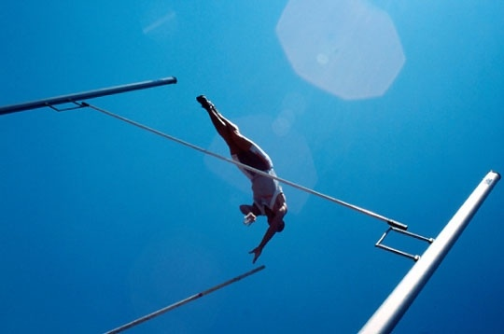
Notes:
2

Slide 3
RIs are at the core of an efficient
EU Research & Innovation strategy
Designed and operated to attract and host the
best researchers in the world (open access - size of research facilities is not the issue, excellence is !)
Help responding to Grand Challenges but need world-level quality in all aspects of their activities:
scientific, educational, technical and managerial
Important role in the advancement of knowledge and technology, liberating creative potential of staff, users and providers,
thus being crucial socio-economic drivers

Slide 4
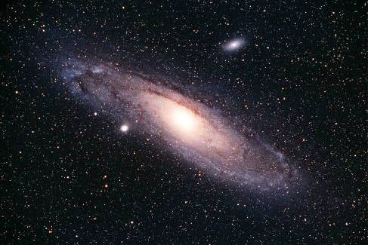
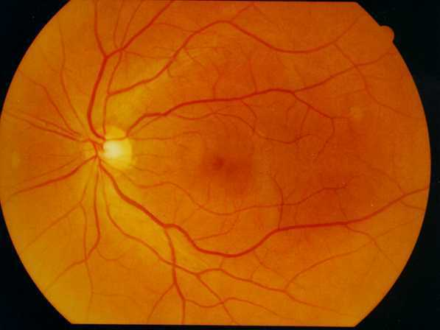
Research Infrastructures are facilities
where basic research as well as applied research are interacting to generate innovations for our daily life
Notes:
“Facilities”, “resources” or “services” that are used by the scientific community for the
development of leading-edge research at EU level
knowledge transmission, knowledge exchanges and knowledge preservation;
This definition covers major equipments, scientific archives and structured information, enabling ICT-based infrastructures, and any other entity of a unique nature used for research.

Slide 5
ESFRI projects
Current Preparatory Phases
Notes:
5

Slide 6
Although the ESFRI projects are very visible,
the “integrating activities” are the most important EC actions

Slide 7
Number of RIs has more than doubled in FP7 versus FP6

Slide 8
Distribution of projects per scientific domain and activity
(since 2007: 137 projects, average funding 8 M€)

Slide 9
Next FP7 actions
WP 2011
To be launched in July 2010 (closing end 2010)
ERANETs continued
a specific support measure
to prepare an FP8 dedicated action
for instrumentation
WP 2012
To be prepared by March 2011
Input welcome from experts, YOU…
International Cooperation?

Slide 10

The future…
More than 500 people
discussing during two days
Importance of excellent research services
(harmonized evaluation criteria needed) and of service-oriented e-infrastructures
EU RI policy based on a partnership approach
between regional, national, EU, global levels
(need for roadmaps)
Importance of human resources for the setting-up and operation of attractive and sustainable RIs
Involving technology suppliers
from an early stage.

Slide 11

A joint vision
should
be agreed...
For Europe, a fully integrated, consistent, efficient
eco-system of Research Infrastructures, serving researchers and society in all S&T fields
At global level, co-operation to tackle global Challenges, based on / feeding excellent research facilities and widely used & efficient e-infrastructures (need for increased inter-agencies cooperation)
Research Infrastructures should act as knowledge industry for the knowledge society: a major cultural change for scientific institutions and agencies
Notes:
11
11

Slide 12

We need addressing
the key factors
affecting the vision and
the capacity to change
Capacity (or not) to work together / pool resources
(thus coordination of national strategies)
to face more complex problems / costly solutions
Capacity (or not) to develop a favorable / catalytic environment for EU & Int’l research & innovation
Capacity (or not) to strengthen relations
with education, the people, and with industry
Capacity (or not) to face
research internationalization
Four EC communications
to come within the next
18 months
Notes:
12

Slide 13
Looking for developing more international cooperation
Global issues
  To be targeted through international cooperation (Carnegie meeting in Nov 2010?)
  GSF-OECD specific action
  Energy RI conference (29-30 Nov 2010, Brussels)
Bilateral actions?
  Workshop on 1 Oct. 2010, in Roma
  More US participation in the EC calls
  AAAs specific workshops in 2011,
  Exchange of experts, etc.
Notes:
13

Slide 14
Facing Challenges... A formula:
U x V x C x F > R
Understanding, Vision,
Capacity to Change, Feasibility,
facing the Resistance to change
Role of this WS

