Slide 1
NSF Experience with Management of Research Infrastructure
Mark Coles
Deputy Director, Large Facility Projects
Office of Budget, Finance, and Award Management
National Science Foundation

Slide 2
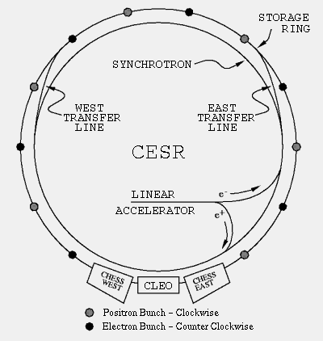
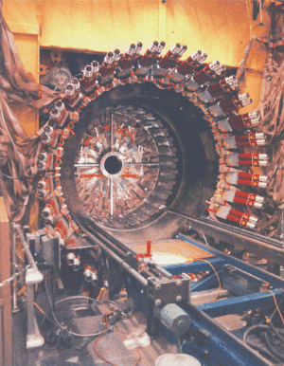
NSF’s Large Research Facility Projects in Physics
The first large NSF facility in physics
Cornell Electron Storage Ring (CESR) -- high-luminosity 6+6 GeV electron-positron collider at Cornell University
> 30 years operation
The centerpiece of NSF High Energy Physics Program for many years
B – Physics
Accelerator Physics
Synchrotron Radiation -- CHESS
LHC
CLEO Collaboration: NSF & DoE
~20 research groups
125 collaborators

Slide 3
Current NSF Portfolio
NSF funds operation of 18 major multi-user research facilities ~$900M in FY 10
Some of these do not have a single dominant (~70%) national partner:
International Ocean Drilling Program
Gemini Observatory
Large Hadron Collider detectors (ATLAS and CMS)

Slide 4
Current NSF Construction
6 facilities under construction by NSF
FY11 budget request ~$165M
One of these – ALMA - does not have a single dominant national partner
Two have significant non-US contributions:
IceCube (TPC=$279M, US=$242)
Advanced LIGO (US=$205, in-kind laser (Germany), suspensions (UK))
Two are networks of Earth observing systems, could benefit from collaborative data sharing
National Ecological Observatory Network (proposed FY11 construction start) (TPC=$434M)
Ocean Observatories Initiative (TPC=$386M)
TPC=total project cost

Slide 5
Some Management Challenges Within an International Framework
Roles and responsibilities of host country
Procurement and acquisition policies for joint undertakings
Access and data sharing policy
Intellectual and physical property issues
Dispute resolution and partnership withdrawal/default mechanism
National agency role with respect to governance
Memoranda of Understanding
Must be carefully negotiated to address challenges
Are only effective when the interests of the participants are aligned
Depend on mutual goodwill to sustain the relationship

Slide 6
NSF “Management” Role
Congress holds NSF accountable for accomplishing scope within requested budget
NSF oversees, but does not manage
Funding provided to Awardee institution
Institution responsible for management and project execution
NSF exercises oversight through review, reporting, site visits
NSF can change awardee institution (recompetition)
Request key staffing changes
This is more complex in international collaboration

Slide 7
Earned Value Reporting
Earned Value Management methodology is a federal financial status reporting requirement for US-funded component
Significant investment to set up and maintain – 1-2% of total project cost
Now used in ALMA across all aspects of project
BUT cannot be imposed on non-US partners

Slide 8
Investment in Pre-construction Planning
Expensive, but essential to development of a credible cost estimate
5-25% (or more!) of total capital cost
Little experience in NSF with joint international planning activities
ALMA (major rebaselining following construction start)
Crucial to learn how to do this effectively

Slide 9
Budget Contingency
NSF has had good experience with budget contingency:
Algorithmic bottom-up assessment of risk to estimate budget for “known unknowns”
Recent examples:
IceCube: 97% complete, within 1% of cost and schedule targets, initial contingency ~25% of estimated budget
ALMA (US, after rebaselining): 81% complete, within 1% of cost and 4% of schedule, ~25% contingency
LHC detectors (US+DOE)

Slide 10
Operating Cost Considerations
Very challenging to estimate many years forward during construction planning:
Need to include funds for scientific use, upgrades, advanced R&D to keep facility fresh
Budget for replacement of long-lived components
Limiting factor in determination of whether to build new infrastructure
Important factor in future international discussions, especially with global management structures

